Slide 1
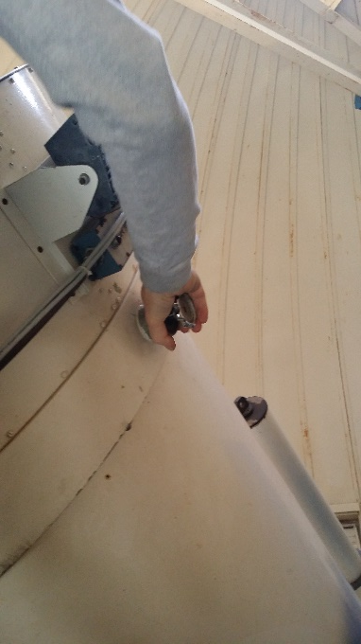
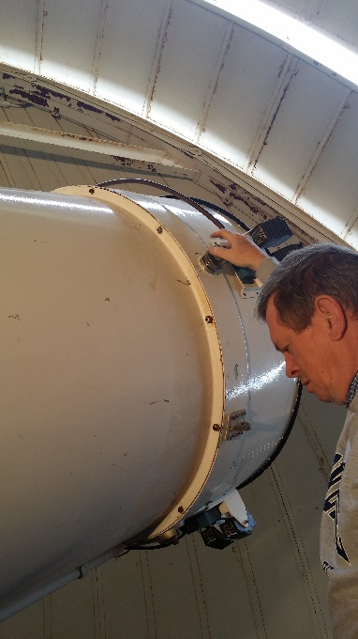
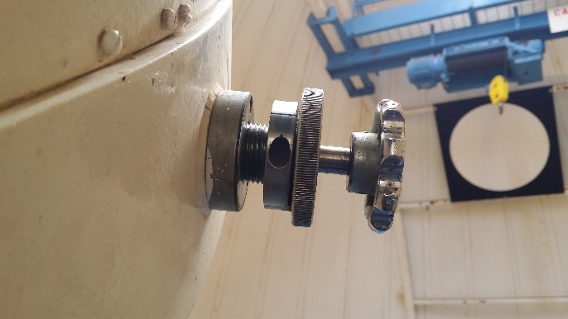
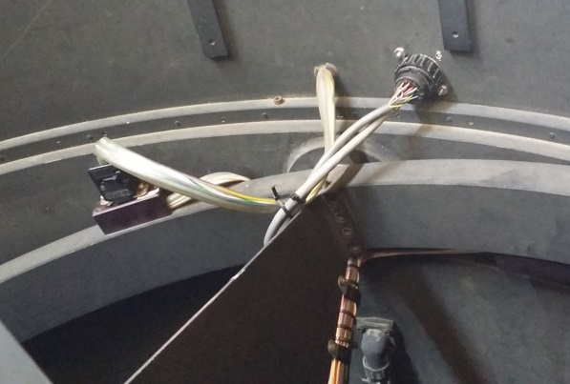
(Preliminary) WIYN 0.9 Meter Collimation Procedure
Tilt the telescope to Mirror Cover Park position
Remove mirror cover
Release the two secondary mirror holder clamps
The East one first – (Figure 1)
Then, holding on to the secondary support,
release the west clamp – (Figure 2)
NOTE: To loosen the secondary mirror clamps, turn the inner locking segment (Figure 3 - A) counter-clockwise, until it’s loose. Then, turn the outer segment, the lock (Figure 3 - B), until it “pops” out.
Unplug the plastic connector indicated in (Figure 4)
Figure 1
Figure 2
A B
Figure 3
Figure 4

Slide 2
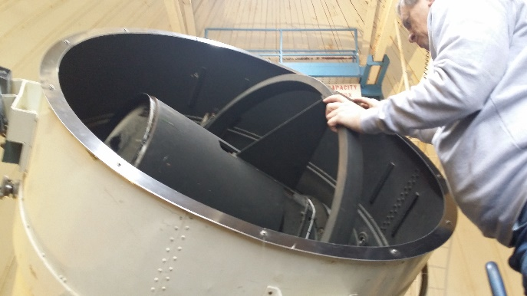
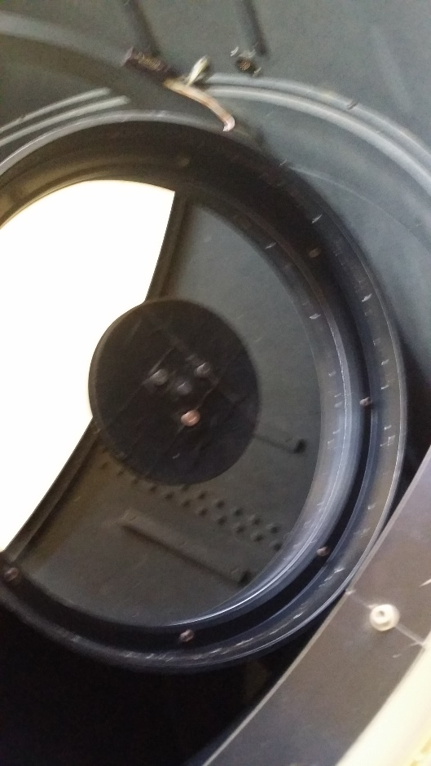
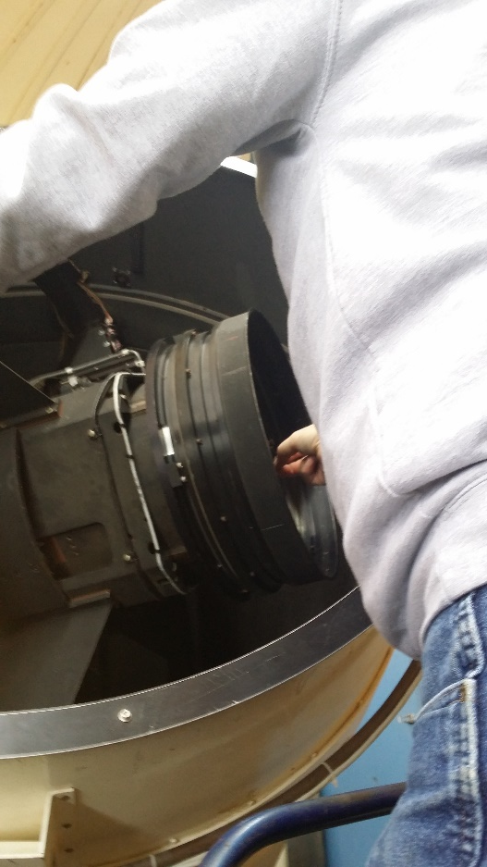
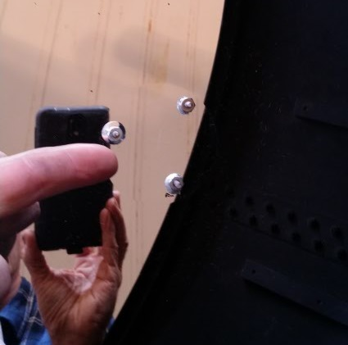
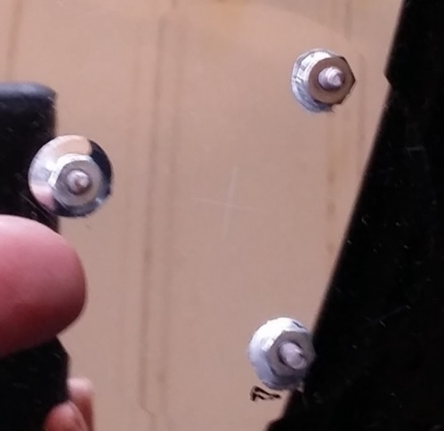
Figure 5
Rotate the secondary mirror assembly ~ 150 degrees, so the front of the secondary can be accessed (Figures 5 & 6)
Remove the black secondary mirror center mask, which is about 4” in diameter via three screws (Figures 6 & 7). This will reveal a small cross that has been etched into the center of the secondary mirror, which is used for this collimation procedure. (Figures 8 & 9)
Figure 6
Figure 7
Figure 8
Figure 9

Slide 3
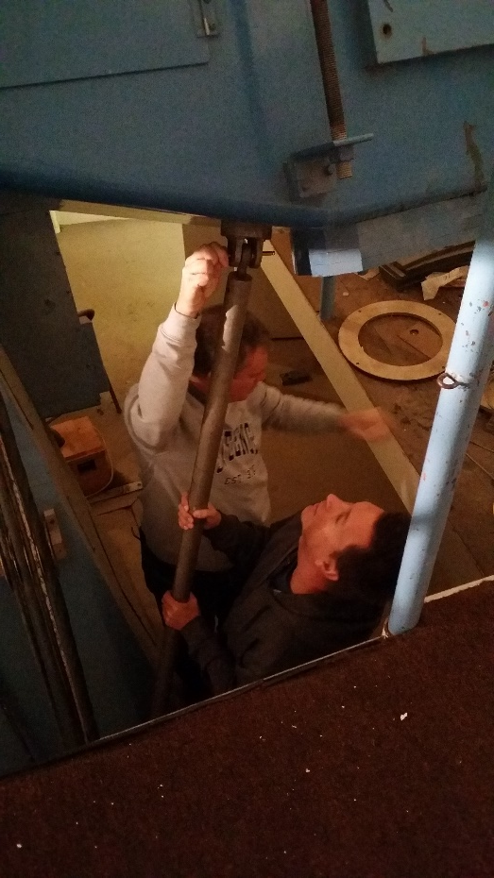
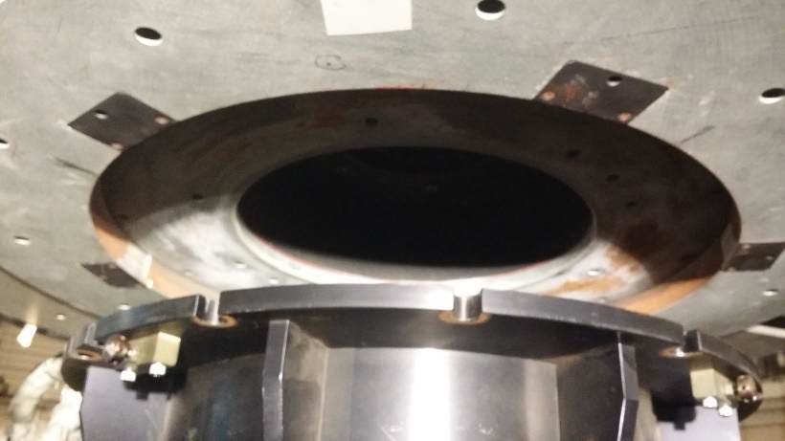
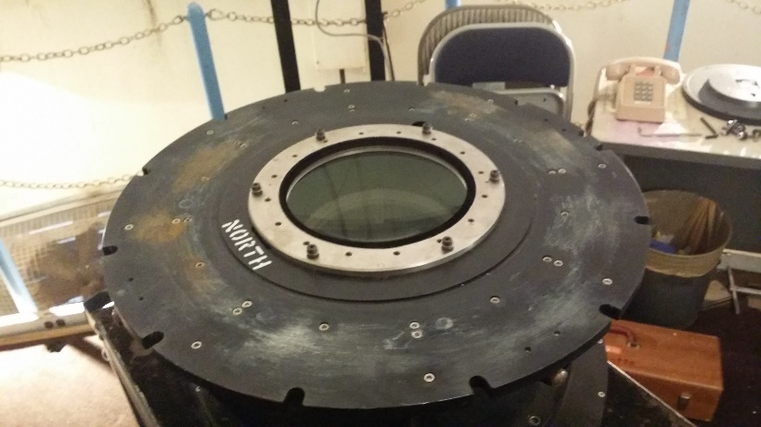
Put the secondary mirror back into its normal position and tighten the east and west secondary mirror clamps and locks.
Plug the plastic connector back in place.
Move the telescope to Zenith Park position.
Install the telescope mount stabilization bar. (The telescope is about to become unbalanced.) (Figure 10)
Remove wiring, power cords etc., that are attached to the guide cameras, filter wheel and imaging (HDI) camera.
Remove HDI and set it off to the side. (It is not necessary to turn OFF HDI or disconnect the primary cooling cables, connected to the camera.)
Remove the telescope optics “corrector/filter wheel” assembly. (Figures 11 & 12)
Figure 10
Figure 11
Figure 12

Slide 4
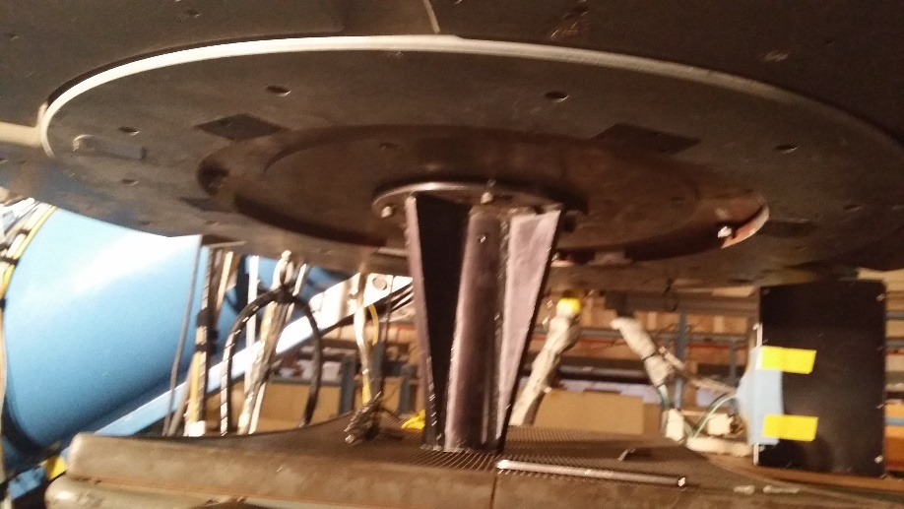
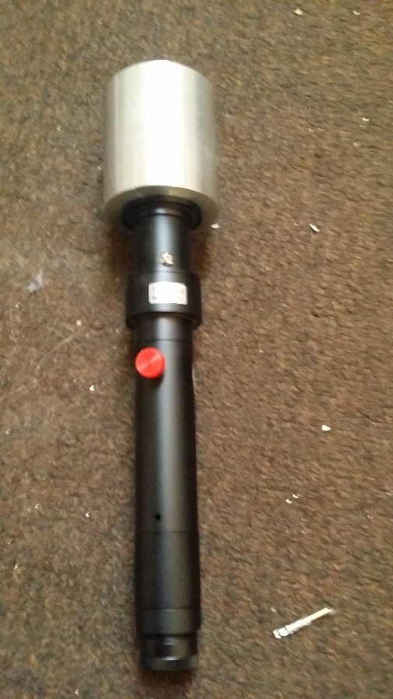
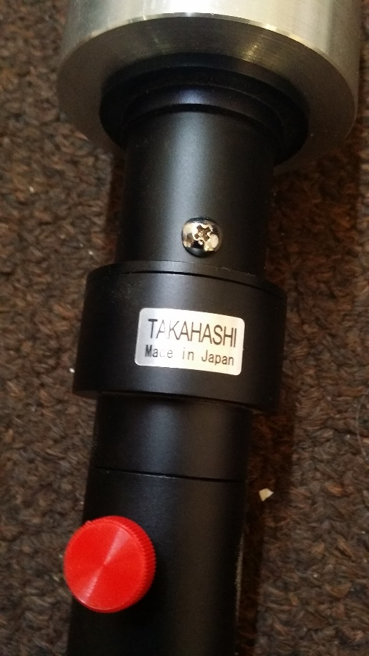
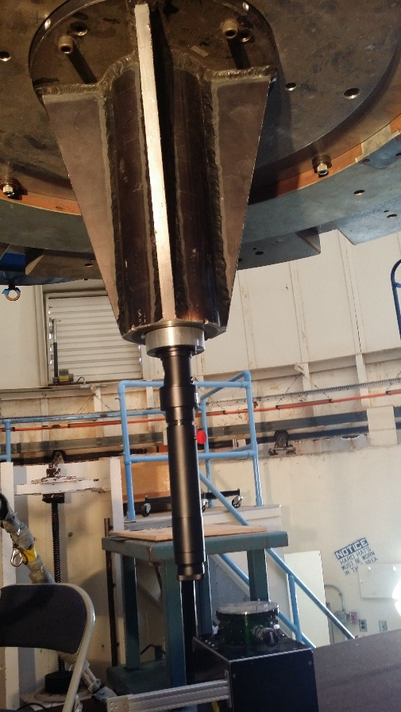
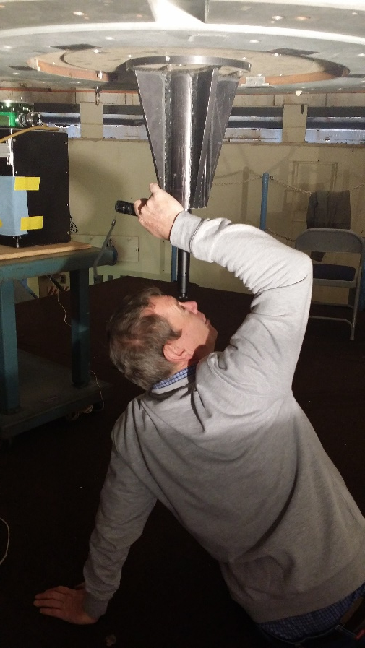
Install the collimator plate/holder assembly. (Figure 13)
Install the Takshashi collimator and look into the collimator to inspect the coarse collimation of the telescope. (Figures 14, 15, 16 & 17)
Figure 13
Figure 14
Figure 15
Figure 16
Figure 17

Slide 5
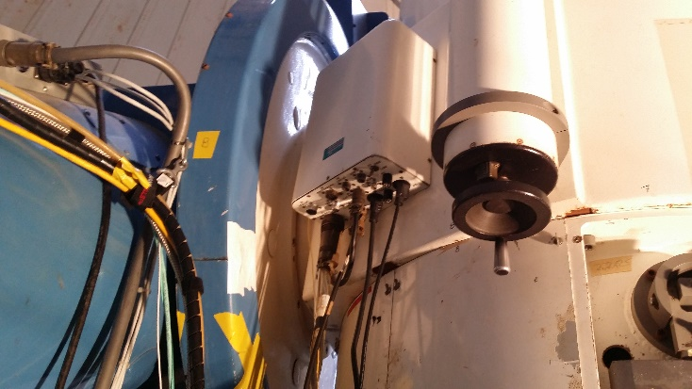
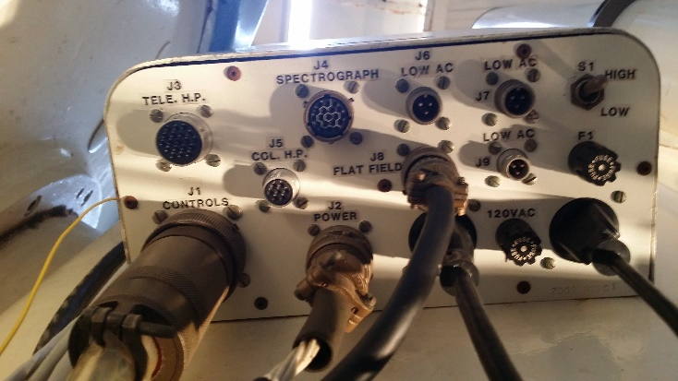
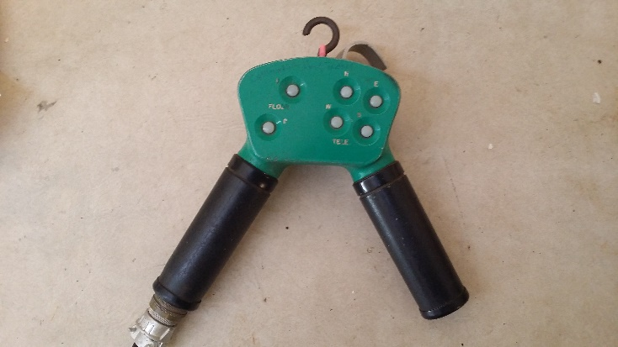
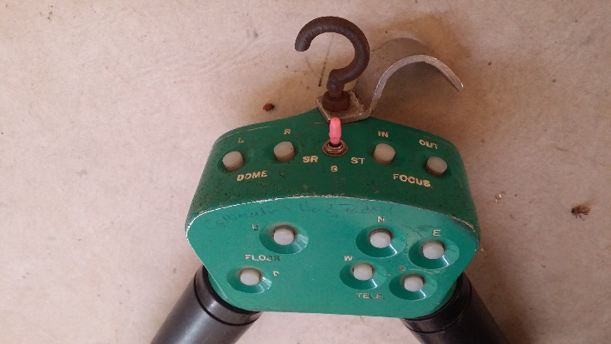
To adjust the collimation of the secondary, plug the collimation hand paddle into the port labelled, “J5 COL H.P.” (Figures 18, 19, 20 & 21)
When the collimation is done, put the telescope back into its default configuration
NOTE: In a later version of this document, we will include a section, where a camera, www.qhyccd.com , is attached to image and collect quantitative collimation data, that will be used to analyze/adjust the concentricity and alignment of the optical components in the telescope.
Figure 18
Figure 19
Figure 20
Figure 21

