Slide 1
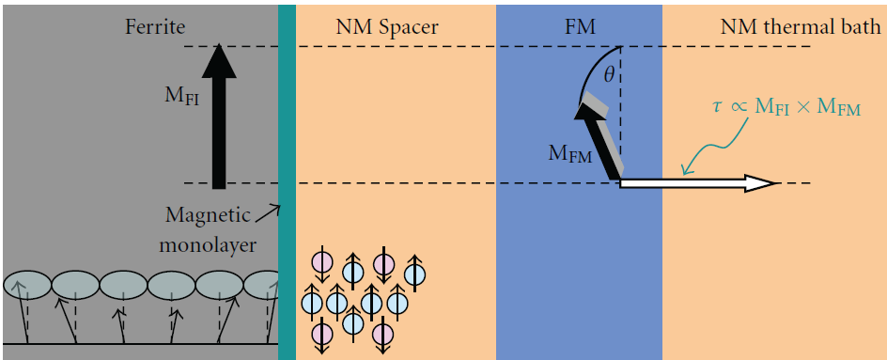
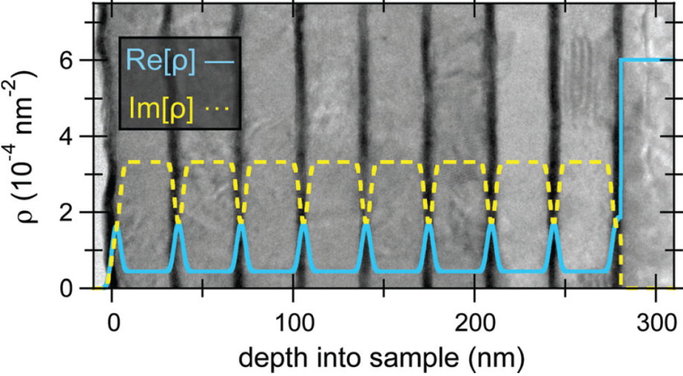
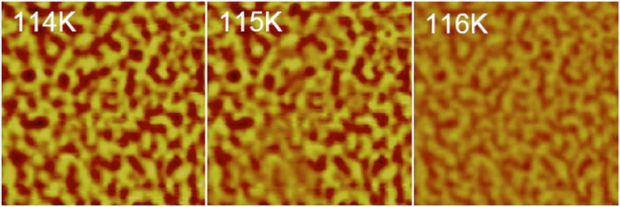
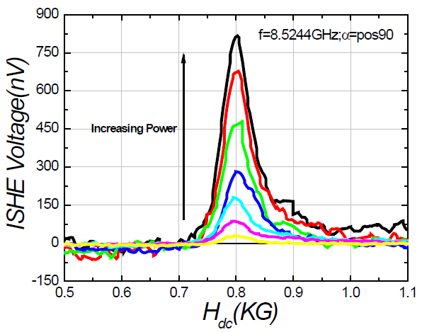
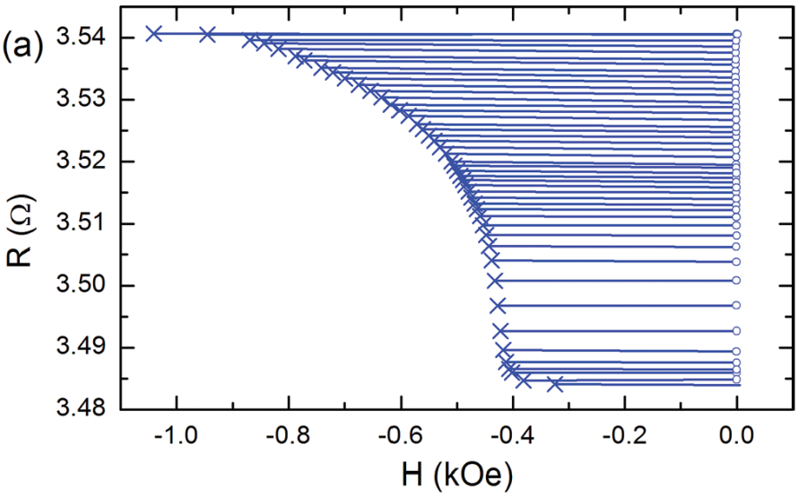
Casey W. Miller
Spintronics, Nanomagnetism
Director, Materials Science & Engineering
cwmsch@rit.edu
Magnons and Spin Torque
Magnetocaloric Effect in Thin Films
Epitaxial Magnetite Thin Films
Spin Pumping, Inverse Spin Hall Effect
Perpendicular Anisotropy Devices

Slide 2
Casey Miller: Thin Films and Heterostructures
Transition Metals, Rare Earths, Complex (and simple) Oxides
Single Crystals, Epitaxial structures, Polycrystalline
7 independent guns, single pocket ebeam
in situ mask exchanging 6-cassette load lock
20 nTorr base pressure Temperatures up to 1000 ºC
Rates 0.05-10 nm/s Layers 0.3 to 300 nm
Magnetotransport
High B, low T; thermopower
Ferromagnetic Resonance 2-40GHz
Dynamics;
spin pumping
Magnetometry
Magneto Optical Kerr Effect (MOKE); VSM
Dynamics
Ultrafast Pump-Probe
Microscopy
MFM, AFM,
TEM, SEM, EDS
Scattering
XRD, XRR, XMCD;
Neutrons
Patterning
e-beam, photo
Spintronics
Magnetic
Sensors
Magnetic Refrigeration
Energetic Materials
Phase Transitions
Energy Harvesting
Magnetic Therapies
Surface Modification
Hard Drive Media
And anything else we can do with thin films!

