Slide 1
Physics of complex and biological fluids
George M. Thurston
School of Physics and Astronomy, RIT
gmtsps@rit.edu
Office: Gosnell 3302; Laboratory: Gosnell 3300/3301

Slide 2


Slide 3
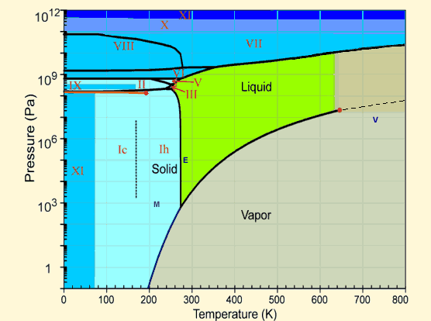
http://www.lsbu.ac.uk/water/phase.html

Slide 4
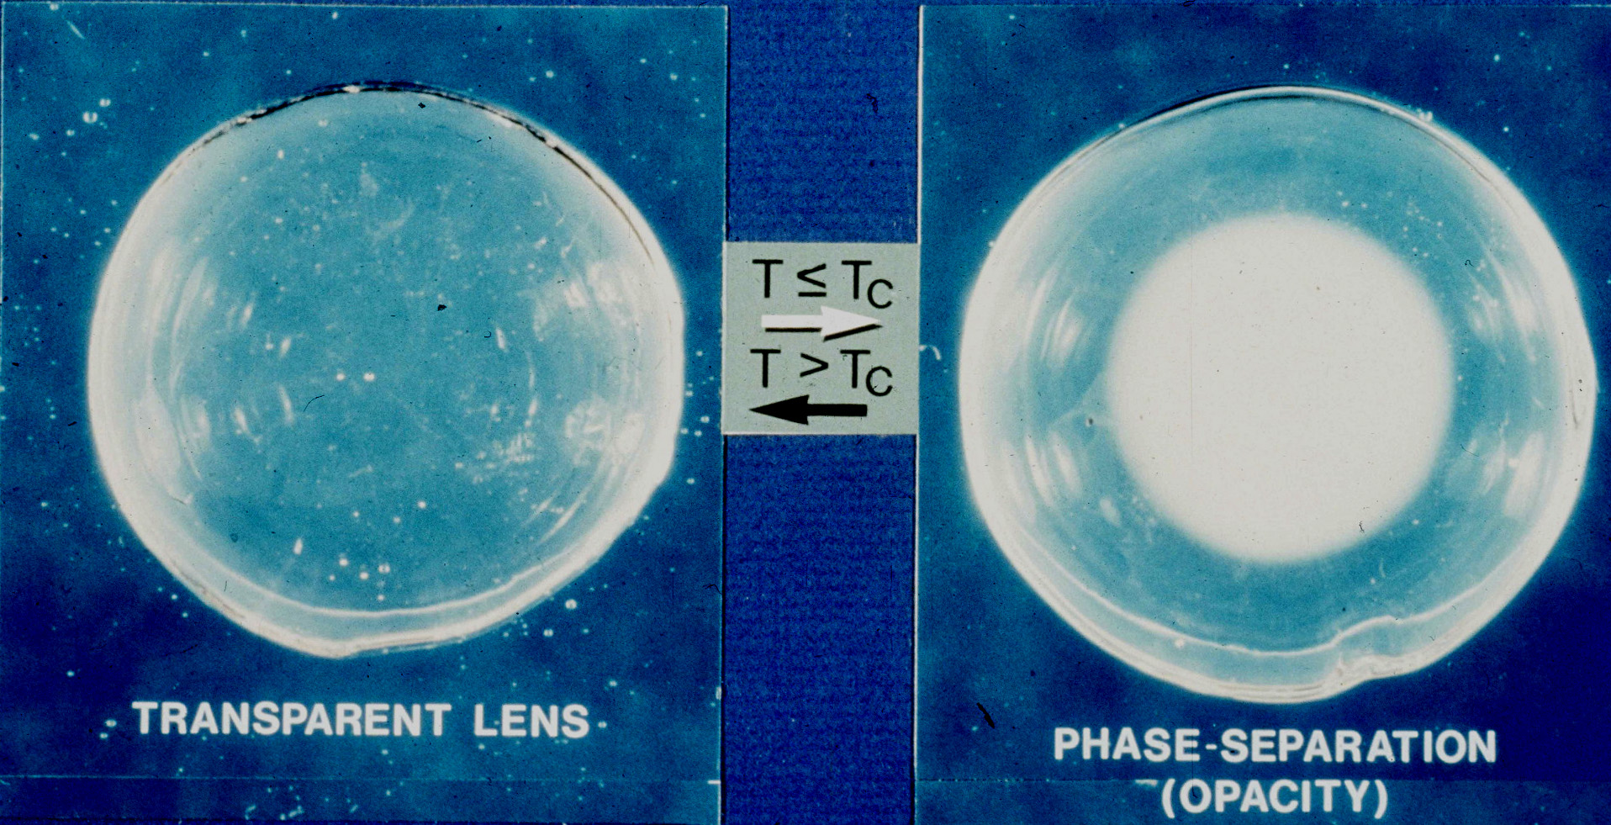

Slide 5
Prof. George B. Benedek
Prof. Felix M.H. Villars

Slide 6
GT, J Chem Phys 2006

Slide 7
Wahle et al, Phys. Rev. E 2017

Slide 8
Central challenges
Single amino acid changes in proteins can cause disease and death by shifting phase boundaries of intracellular molecules.
Many different types of phase transitions occur inside living cells. They create physiological switches.
There is no predictive, quantitative, physics-based theory for the vast majority of these transitions, and for those that are better modeled, there is no predictive theory for how single amino acid mutations alter such phase boundaries.
Related diseases: cataract, sickle-cell disease, ALS, cryoglobulinemia, type-2 diabetes, prostate cancer, more
Cell physiology: intracellular stress and immune responses, ribosome assembly, regulation of gene expression

Slide 9
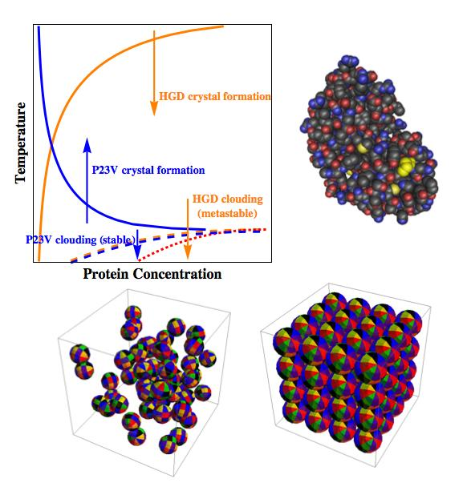
Example from
J. McManus et al, PNAS (2007); Commentary GT, PNAS (2007)

Slide 10
Liquid-liquid phase transitions are involved in many normal and pathological processes in living cells, ranging from stress response and sensing to control of gene expression to a host of neuropathologies, including ALS, and initial stages of cancer.
From Alberti, Gladfelter, and Mittag, Cell, 2019

Slide 11
The sorts of subjects and activities that can be involved – many of which one can at least start to learn by doing - including as a first-year student
Experiments: sample preparation, phase diagram determinations, light, X-ray, and neutron scattering, nuclear magnetic resonance
Computer simulations and computation: Monte Carlo simulation, molecular dynamics simulation, quantum chemistry package calculations, data analysis
Physics theory areas involved: statistical physics, quantum mechanics, mechanics, electromagnetic theory, and fluid mechanics.
Math involved: multidimensional and variational calculus, probability theory, linear and nonlinear ordinary and partial differential equations, integral equations, geometry, numerical methods.
Chemistry involved: gaining familiarity with biological molecules, experimental techniques of analytical chemistry, including UV spectrophotometry, mass spectrometry, and acid-base titration
Biology involved (if you want): recombinant DNA production of proteins

Slide 12
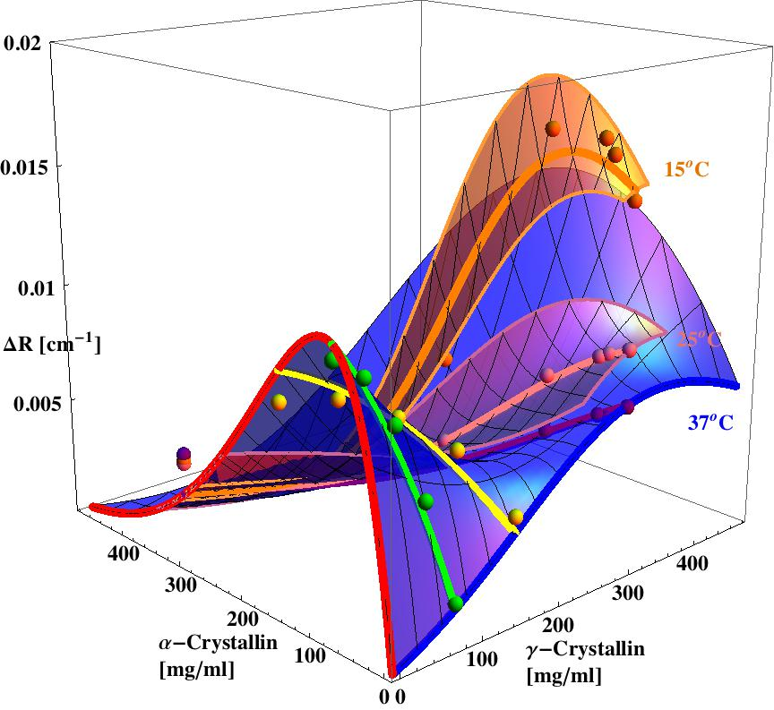
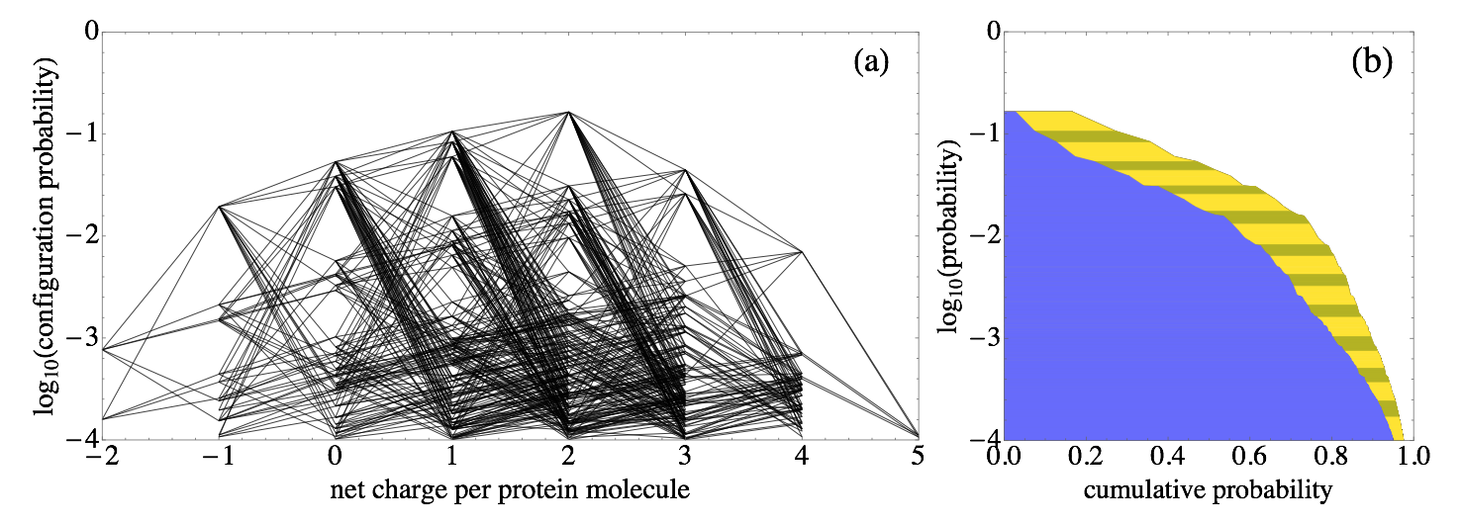
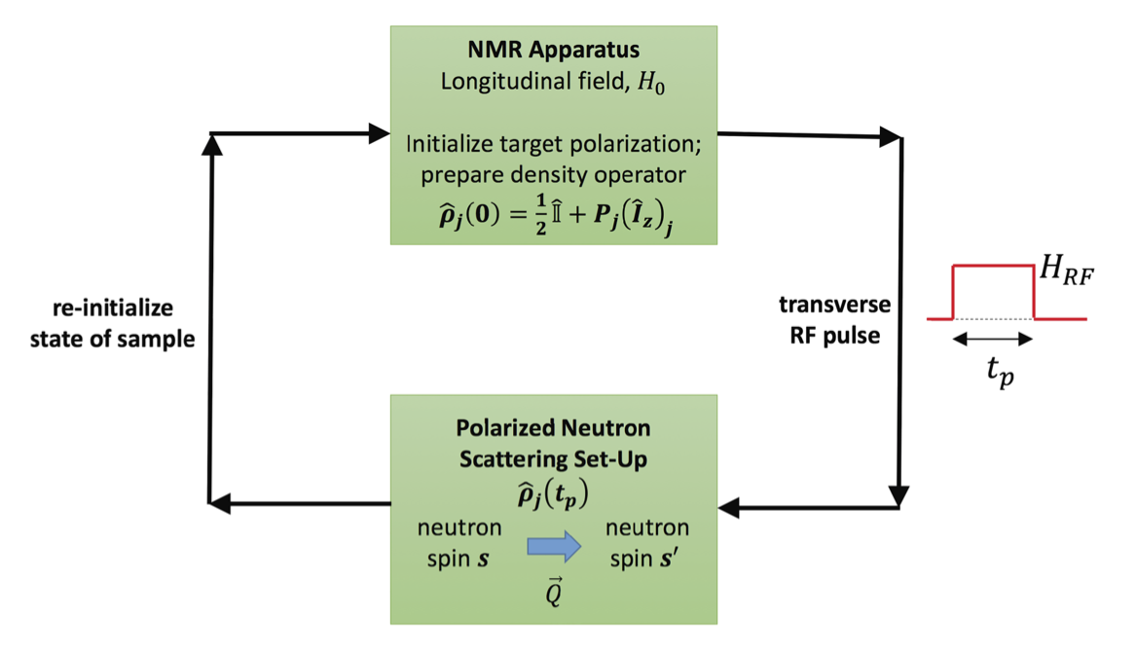
Three out of the current, ongoing projects
Statistical thermodynamic model for ->
measured light scattering efficiency of eye lens protein mixtures (M. Bell et al, J. Chem. Phys . (2017))
<- Statistical thermodynamic model for protonation statistics
of an eye lens protein (C. Wahle
et al, Phys. Rev. E., 2017)
Quantum mechanical basis for -> combining nuclear magnetic resonance (NMR) and neutron scattering (M. Kotlarchyk and G. Thurston, J. Chem. Phys. (2016))

Slide 13
Project areas. Many have aspects that can be suitable for undergraduates at any level:
1. Orientation-dependent, charge-regulated, short-range interactions of proteins
a) modeling and characterization of close-range free energy landscapes for interactions
b) practical screened electrostatic approximations for charge-regulated interactions
c) applying integral equation theories of electrolyte solutions to charge-regulation of proteins
d) simulation of protein solutions with short-range, orientation-dependent interactions
2. Charge-regulation on flat layers and in membranes
a) charge-regulated pattern formation phase transitions in flat and curved solid layers
b) charge-regulated interactions of solid and fluid stacked membrane layers
Statistical-thermodynamic modeling of aqueous mixtures of charge-regulated globular and intrinsically disordered proteins and other biological molecules, including phase transitions
a) statistical thermodynamics of ternary and quaternary mixtures of eye lens proteins
b) modeling of quaternary mixtures important in the physical chemistry of bile
c) enzyme kinetics in concentrated mixtures of interacting, attracting proteins
4. Nuclear magnetic resonance, spin-modulated neutron scattering
a) statistical methods for robust spin-modulated neutron scattering signal detection
5. Coupled rotational and translational Brownian dynamics of interacting proteins
a) theory, modeling, and simulation of combined hydrodynamic and direct interactions of proteins
6. NMR chemical shift perturbation for probing protein interactions
a) quantum-chemical calculations of electric field and protein conformation effects on chemical shifts
7. Application van der Waals interaction theory to globular proteins
a) application of recent theory suitable for modeling influence of protein shape on van der Waals interactions
8. Aggregation of the eye lens protein, alpha crystallin
a) modeling of the kinetics of aggregation
Modeling liquid-liquid phase separation in amyotrophic lateral sclerosis (ALS) and normal physiology
Development of new light scattering methodology for direct measurement of Gibbs free energies of mixing

